Slide 1

Java course
-9-

Slide 2
8.Hibernate

Slide 3

What is a Hibernate?
Hibernate ORM (Hibernate in short) is an object-relational mapping tool for the Java programming language. It provides a framework for mapping an object-oriented domain model to a relational database. Hibernate handles object-relational impedance mismatch problems by replacing direct, persistent database accesses with high-level object handling functions

Slide 4
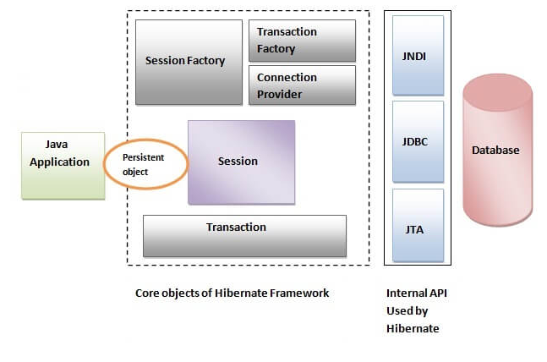
Hibernate Architecture

Slide 5
Hibernate Features
SessionFactory
The SessionFactory is a factory of session and client of ConnectionProvider. The org.hibernate.SessionFactory interface provides factory method to get the object of Session.
Session
The session object provides an interface between the application and data stored in the database. It is a short-lived object and wraps the JDBC connection. It is factory of Transaction, Query and Criteria.The org.hibernate.Session interface provides methods to insert, update and delete the object.
Transaction
The transaction object specifies the atomic unit of work. It is optional. The org.hibernate.Transaction interface provides methods for transaction management.
ConnectionProvider
It is a factory of JDBC connections. It abstracts the application from DriverManager or DataSource. It is optional.
TransactionFactory
It is a factory of Transaction. It is optional.

Slide 6
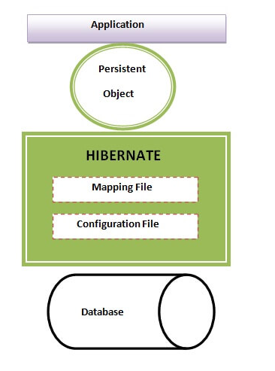
Data Access

Slide 7
Creating a spring boot-jpa-hibernate project
Go to https://start.spring.io/
Click Switch to full version link to see all the options
Enter Artifact as “<project_name”
Change Package Name to “com.<youre_name>”
Select Web, JPA and Mysql dependencies.
Click Generate Project to download the project.
In Project Explorer rightclick and import
Import from folder or archive
Update maven project

Slide 8
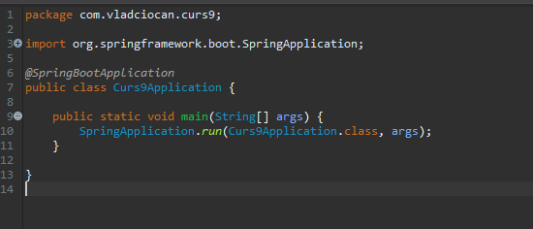
SBA Main Class

Slide 9
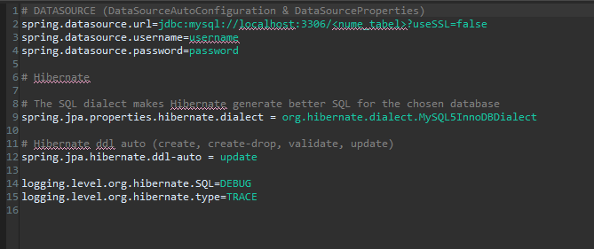
Edit application.properties

Slide 10
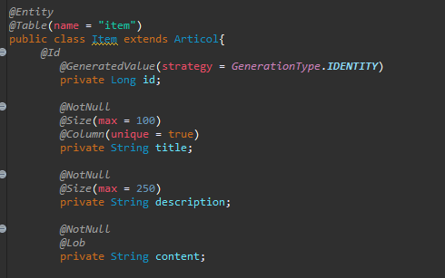
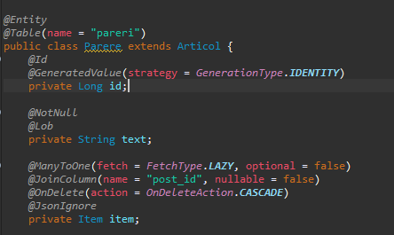
Create 2 entities

Slide 11
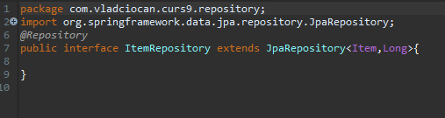
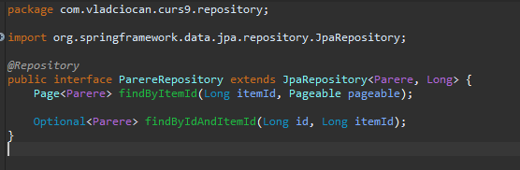
Create Repository classes

Slide 12
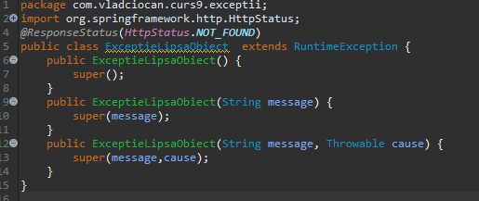
Create a Exception class

Slide 13
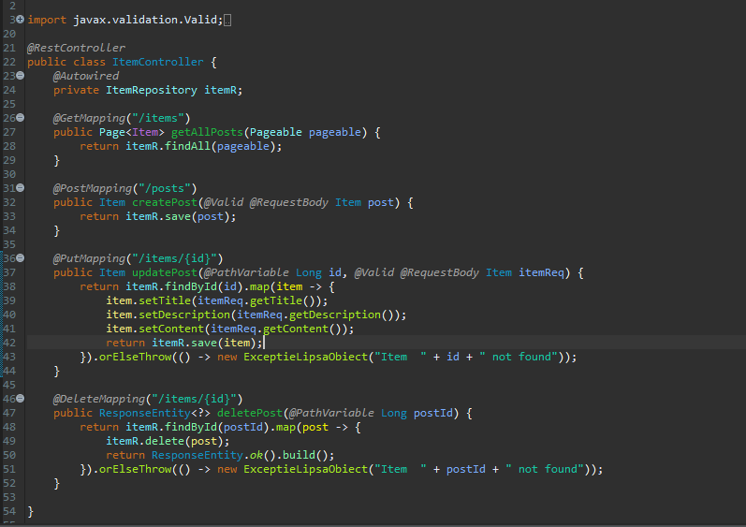
Create the controllers

Slide 14
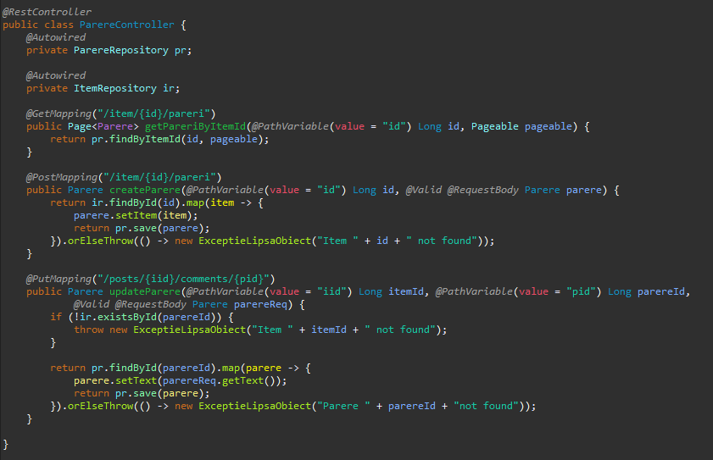
Create the second controller

Slide 15
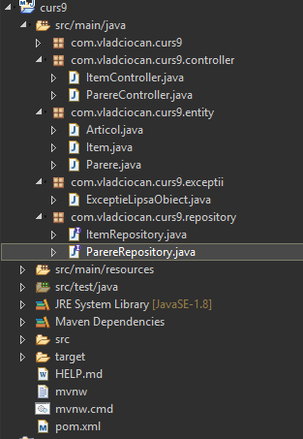
Done.

Slide 16
Finishing touch
-Update maven project
-Right Click -> Run as ->Java Application

Slide 17
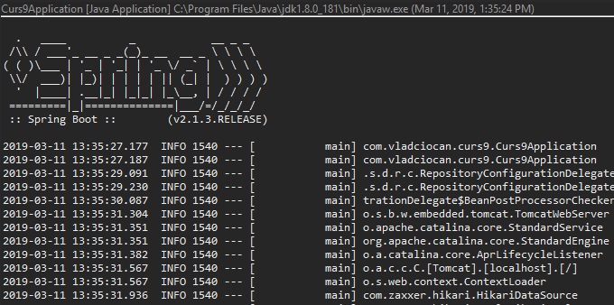
Run as Java Application

Slide 18
That`s it for today
Session review
-You learned Hibernate
-You learned about DataSorces
-You learned annotations
GOOD JOB! ☺

